Slide 1








MBTA Construction Contract No. T90CN06 Emergency Track Improvement – Orange Line
Chief of Engineering and Capital Sam Zhou
January 25, 2024

Slide 2
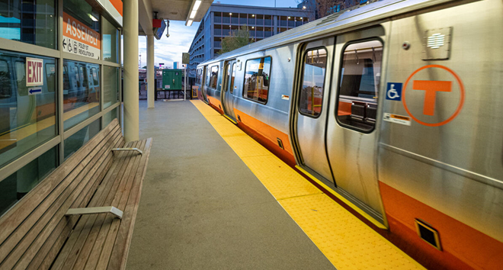
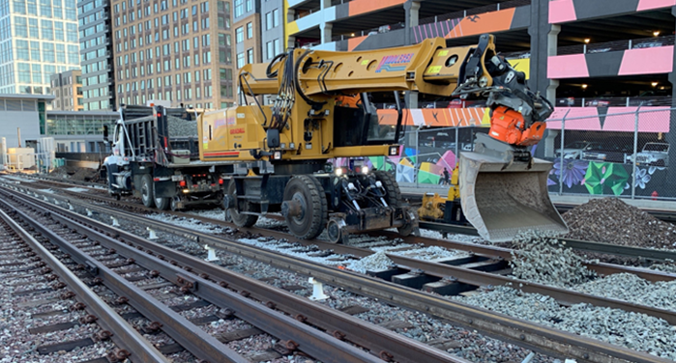
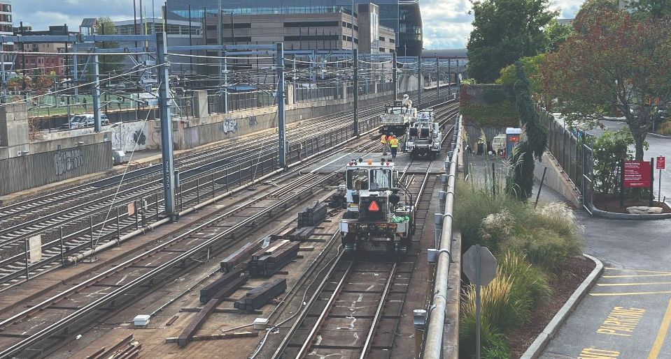
Contract Information
Today’s presentation will provide background information on procuring contracted construction services in the amount of $25,400,660 for Emergency Track Improvement – Orange Line through MBTA Contract No. T90CN06, which will consist of track rehabilitation to support the MBTA in addressing speed restrictions and state of good repair on the Orange Line, thereby increasing the MBTA’s ability to provide a safe and reliable trip and improve the overall quality of service.

Slide 3
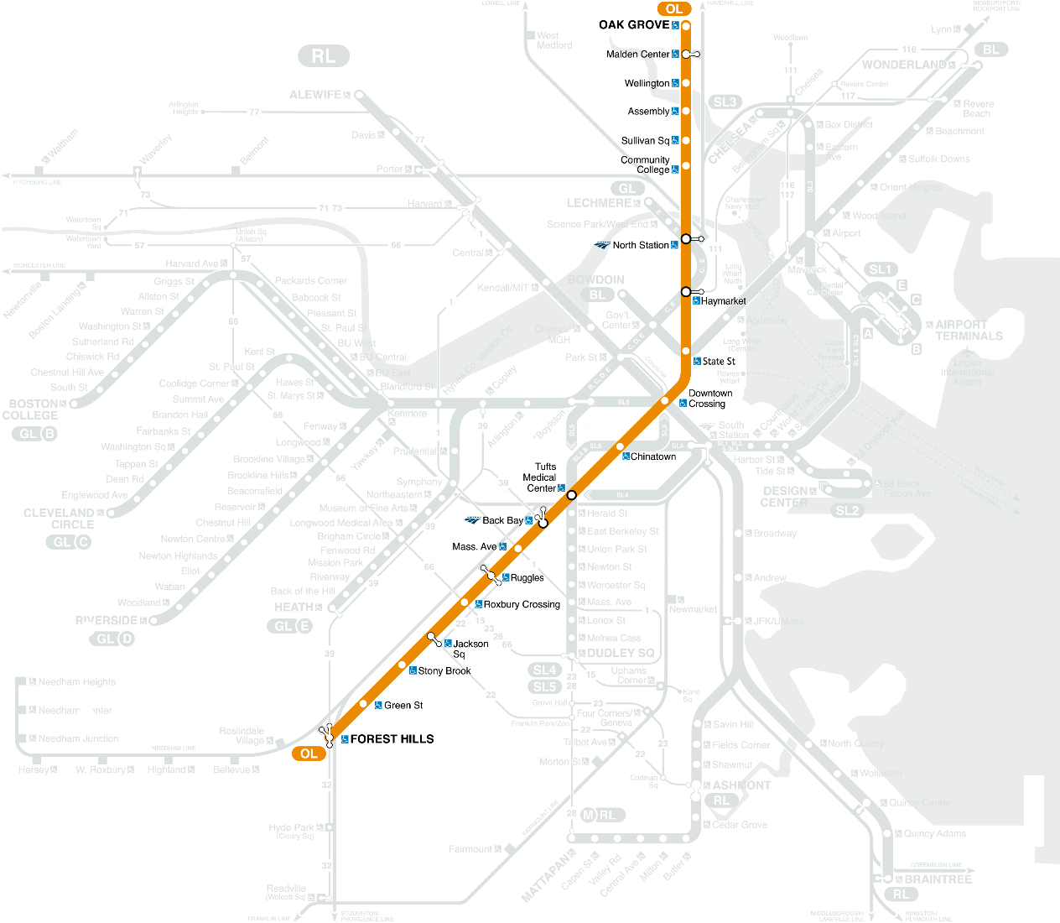
Overview of the Project | Lift 41 SRs in 40 Days
Segment | Alternative Service Area | Speed Restrictions | Total Outage (days) | Start Date | End Date
OL-001 | Oak Grove to North Station | 13 | 6 | 8/17/2024 | 8/22/2024
OL-002 | Wellington to North Station | 5 | 9 | 6/22/2024 | 6/30/2024
OL-003 | Sullivan Square to Back Bay | 6 | 10 | 5/28/2024 | 6/6/2024
OL-004 | Haymarket to Jackson Square | 2 | 4 | 3/18/2024 | 3/21/2024
OL-005 | Back Bay to Forest Hills | 15 | 11 | 9/25/2024 | 10/5/2024
S1: Oak Grove to North Station
S2: Wellington to North Station
S3: Sullivan Square to Back Bay
S4: Haymarket to Jackson Square
S5: Back Bay to Forest Hills

Slide 4
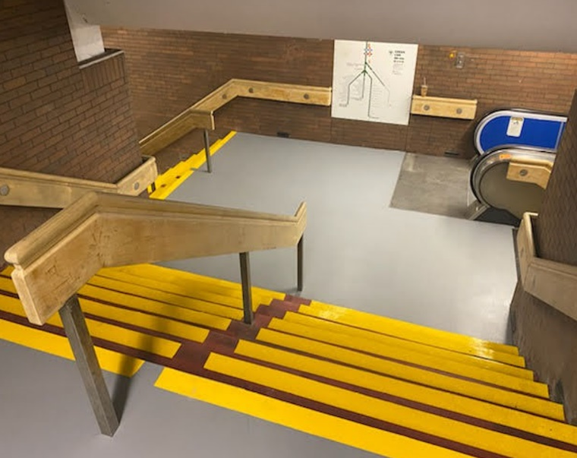
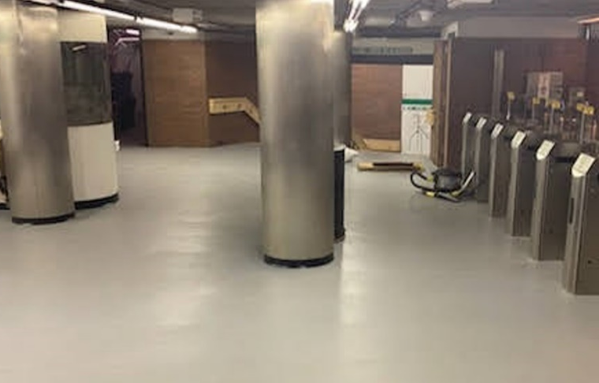
Overview of the Project | Piggyback Work
Proposed Improvements
May include station repairs (paint, bench repairs, concrete, repairs, floor repairs, stair tread replacement, hand-rail replacement, ceiling panel removals, waste receptacle replacement, plumbing & HVAC maintenance, and inspection activities), structural inspections and repairs, fire and life safety work, signal maintenance and upgrades, and power maintenance and upgrades.
Benefits
State of Good Repair, Enhanced attractiveness
Improved Reliability
Increased Safety
Consistent cleanliness, brightness, overall ambiance

Slide 5
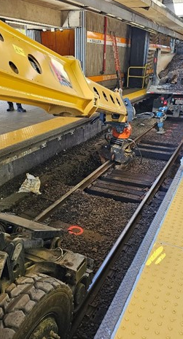
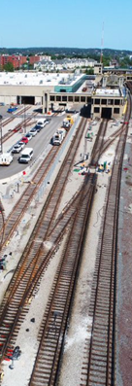
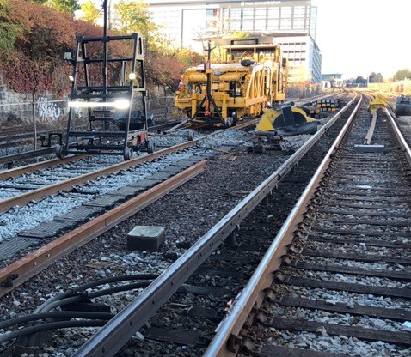
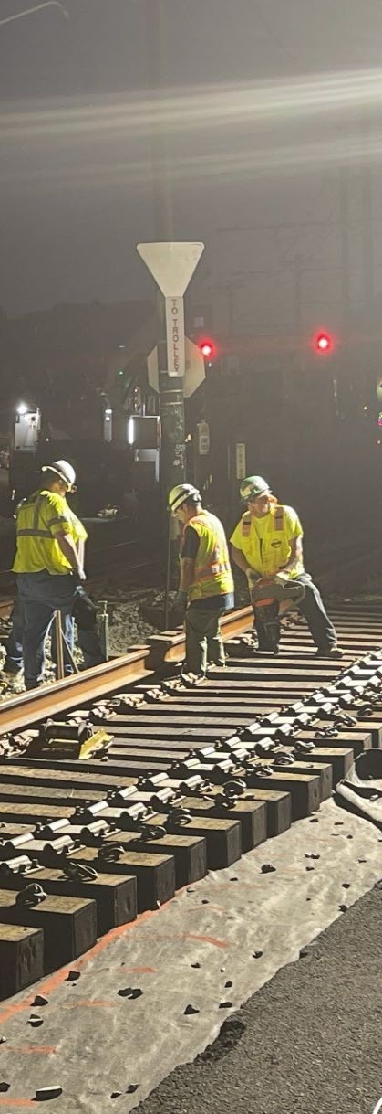
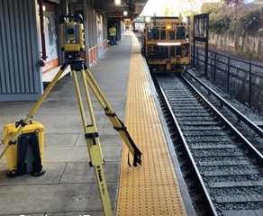
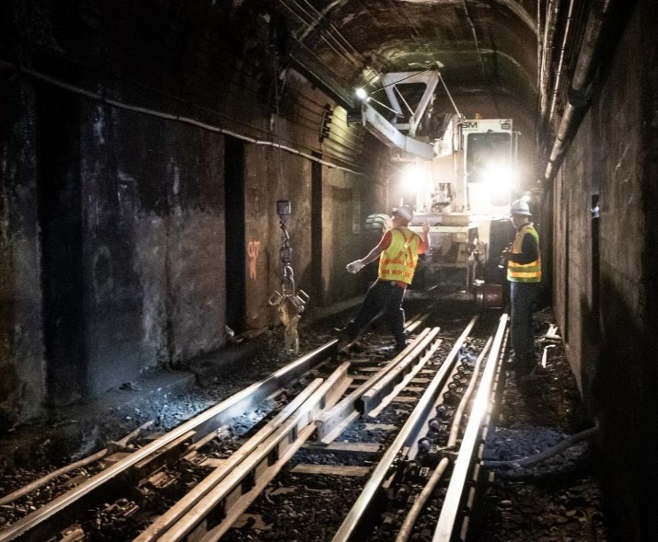
Improved Quality of Service
Planned Improvements
Full-depth track replacement
Rail and tie replacement
Tamp, surface, and align tracks
Benefits
State of Good Repair
Improved Reliability
Increased Safety
Removal of 41 Speed Restrictions

Slide 6
Construction of the Contract
Construction Procurement proactively contacted track contractors (both inside and outside of Massachusetts) to understand their reluctance to bid on track On-Call contracts
Contract packaged to increase competition by:
  Packaging defined scope by lines
  Providing pre-planned continuous access over a period of time
Pre-bid activities
  Pre-bid bus tour of track pads for access
  Schematics and videos of track made available
Included Incentive and Disincentive Language

Slide 7
Construction Procurement
Project advertisement: December 20, 2023
Bid opening: January 23, 2024
DBE Goal: 5%
Three bids received:
  The Middlesex Corporation $25,400,660.00
  Skanska Delta, Joint Venture $27,900,000.00
  Railroad-SPS New England, a Joint Venture $36,201,634.00
  A bid analysis was completed and The Middlesex Corporation is the selected lowest, eligible, and responsible qualified low bid

Slide 8
Board Action | Emergency Track Improvement – Orange Line
To authorize the MBTA General Manager or his designee, to award and execute MBTA Contract No. T90CN06: Emergency Track Improvement – Orange Line with The Middlesex Corporation in the amount of $25,400,660, with a contract duration of 365 days after Notice-to-Proceed.

