Slide 1
MBTA Construction Contract No. Q09CNO2: Green Line D Branch Track and Signal Replacement Beaconsfield to Riverside
June 25, 2018

Slide 2
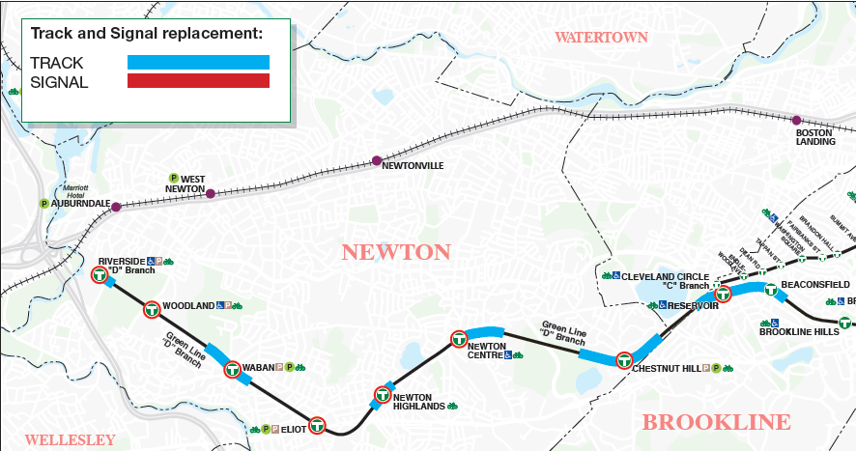
OVERVIEW
Contract Q09CN02: Green Line D Branch Track and Signal Replacement – Beaconsfield to Riverside
Today’s board action will provide for the replacement of track and signals on the Green Line D Branch between the Beaconsfield and Riverside Stations. The project is located in the Town of Brookline and City of Newton, MA.

Slide 3
Construction Scope
Contract Q09CN02: Green Line D Branch Track and Signal Replacement – Beaconsfield to Riverside
The project includes the replacement in kind of track sections and the signal system improving safety and reliability of the Green Line D-Branch service and a system that is easier to maintain.
The project includes:
Install modernized signal system infrastructure between Riverside and Reservoir
Centralized signal system equipment
Upgrade track-side signal infrastructure (signals, track switch machines, cables, cable hanging system)
Install redundant power supply system
Full depth reconstruction of 25,000 LF of mainline track
Upgrade all crossovers and track switches
Reconstruct pedestrian crossing and truck pads

Slide 4
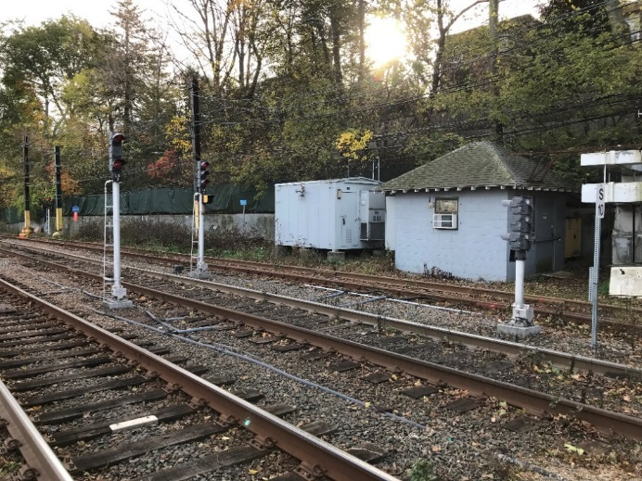
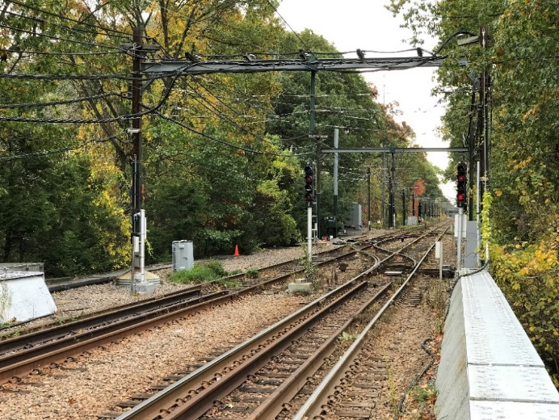
Project Benefits
Contract Q09CN02: Green Line D Branch Track and Signal Replacement – Beaconsfield to Riverside
Modern signal system will result in fewer delays
Fewer signal related delays will increase reliability of Green Line operations
Centralized Instrument Houses at stations will result in workers spending less time traveling to equipment and isolating problems
Speed restrictions due to existing track conditions will be removed on the “D” Branch

Slide 5
Construction Advertisement and Bid
Contract Q09CN02: Green Line D Branch Track and Signal Replacement – Beaconsfield to Riverside
Project was advertised on May 7, 2018
Engineer’s Estimate was $66,583,700
Bid Opening was on June 19, 2018
Three (3) Bids were received
$74,000,000 Barletta-Fischbach Green Line D Branch JV (Low Bidder)
$79,937,700 J.F. White
$107,135,700 SPS/Dagle JV
Bid analysis has been completed. Based on the analysis the variance between the Engineer’s Estimate and the low bid is attributable to: tariffs, steel prices, supply & demand and assumed production rates for trackwork.

Slide 6
Request of the Fiscal and Management Control Board
Contract Q09CN02: Green Line D Branch Track and Signal Replacement – Beaconsfield to Riverside
Staff request that the Fiscal and Management Control Board authorize the MBTA General Manager and CEO, or his designee, to award and execute MBTA Construction Contract No. Q09CN02: Green Line D Branch Track and Signal Replacement – Beaconsfield to Riverside with Barletta-Fischbach Green Line D Branch Joint Venture for an amount not to exceed $74,000,000.

