Slide 1
Blue Line Program
October 1, 2018

Slide 2
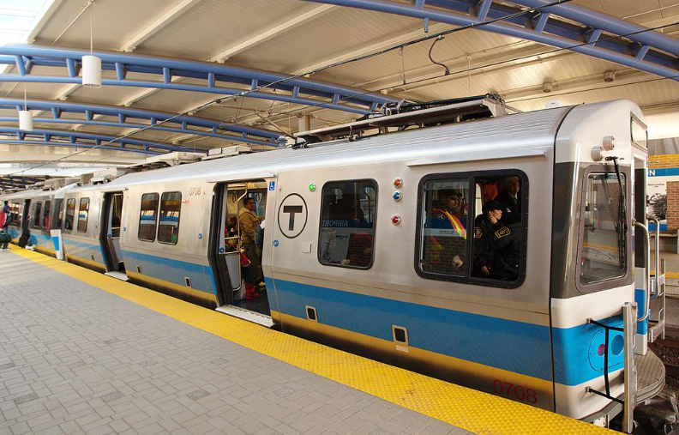
Blue Line Program
Blue Line Overview
Heavy Rail Service since 1924
Tunnel Infrastructure from 1904
Bowdoin to Wonderland
      Under Boston harbor
69,500 Daily Ridership
~ 6 miles long
Mixed power infrastructure
      Third rail and overhead Catenary
Vehicles 15 years old
      72 Vehicles during peak service
      Vehicle procurement in 10+ years
Only rail transit line with Logan Airport Access

Slide 3
Blue Line Program
Previous Blue Line Program
Executed between 1993 and 2016
Maintenance Facility: New Car House at Orient Heights and Rebuild Yard
Fleet: Increased train set from 4 cars to 6 cars
    94 Seimens Dual Powered (3rd Rail and Overhead Catenary)
    Introduced from 2007 through 2009
Infrastructure:
    System-wide power upgrades to 3rd Rail and Catenary System
    2.5 Mile Track Upgrades
Stations: Upgraded and Lengthened 11 station platforms
    Reconstructed Orient Heights Station
    Reconstructed Government Center

Slide 4
Blue Line Program
Blue Line Focus Areas
Problem Statement: Drive service reliability and improvement through infrastructure investment
Service delays due to trip-stop (signal) reliability
Reduced speed zone due to track condition in constrained corridor
Susceptible to storm surge flooding
Upgrade infrastructure with event recovery considered
Infrastructure
State of Good Repair
Obsolescence
Resiliency
Storm Surge
Catenary Removal
Capacity
Service Capacity Improvement Study
Operational Efficiency
Tunnel Structure
Accessibility Improvements
Water Mitigation
Equipment protection/ relocation
Monitoring and Sensing

Slide 5
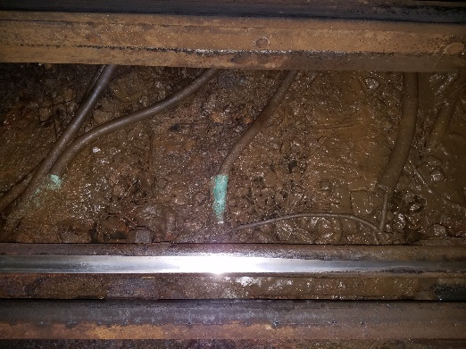
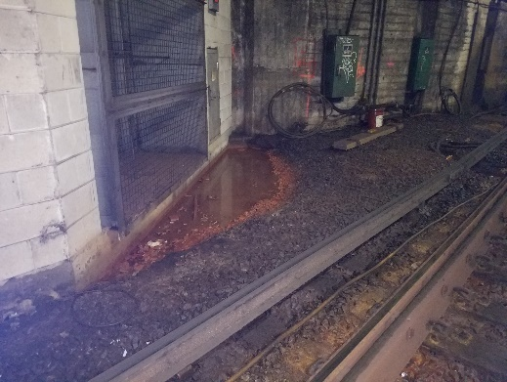
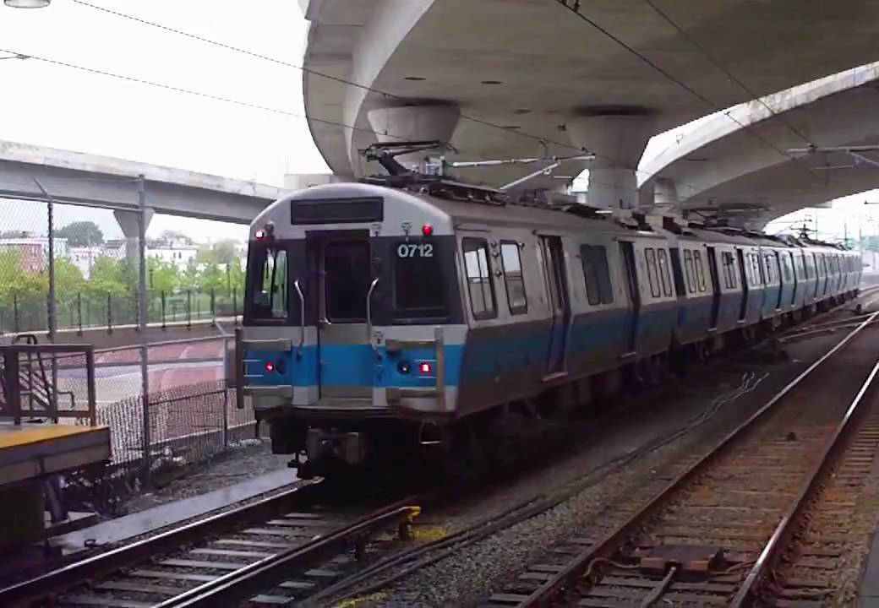
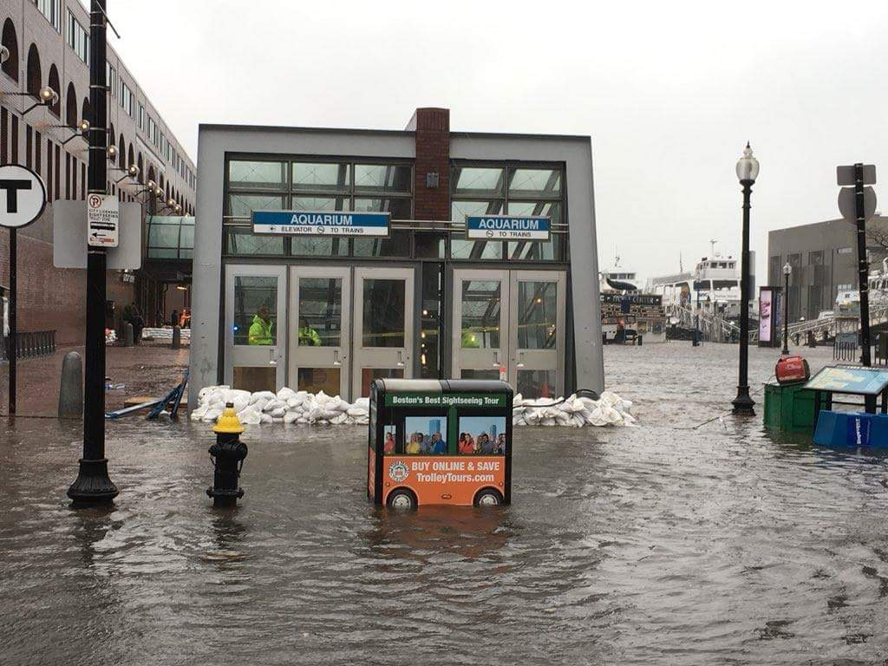
Blue Line Program
Example Blue Line Issues
Leakage and corrosion at Maverick Platform
Corroded cables due to water at Maverick
Standing puddle of water at Maverick
3rd Rail + Overhead Catenary Power
Flooding at Aquarium Station

Slide 6
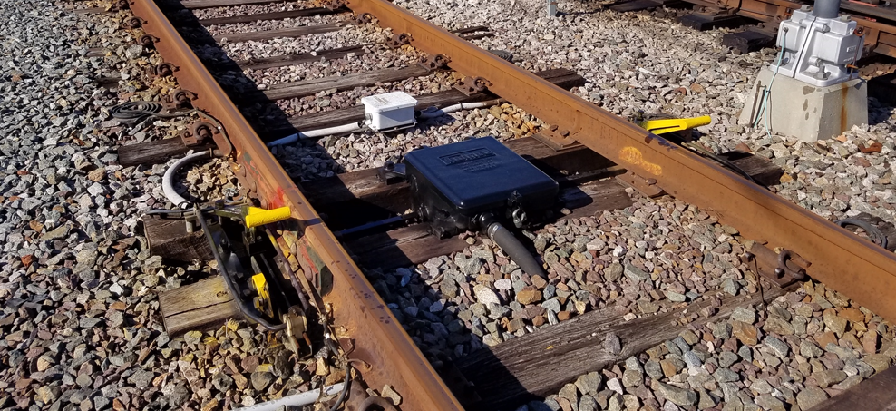
Blue Line Program
Infrastructure Improvements
Currently executing
      Maverick to Aquarium Track and Tie replacement (most Critical only)
        3000 ft. of rail to remove worn and jointed rails plus tie work – Results will improve travel time by 2 minutes
      Platform Inspections – 100% complete
Planned efforts
      Blue Line Signal Study
        Mechanical Trip Stop replacement
        Electronics obsolescence
        Maneuverability improvements
      Long Wharf Vent Shaft and Egress Rebuild
      Maverick to Aquarium Infrastructure Assessment
      Elevator Program - Wood Island and Beachmont
Future program elements
      Capacity Improvement Study
      Suffolk Downs Facility Rehabilitation
      Power
        Infrastructure Upgrades
        Traction Power Conversion to all 3rd Rail
      Signal Upgrade
      Tunnel Repairs
      Parking facilities
      Ongoing Track Work
Mechanical Trip Stop in the “stop” position

Slide 7
Blue Line Program
Resiliency Improvements
Underway By Environmental Department
      Aquarium Station to Maverick Portal Flood Resiliency Study
        Assessing/mapping all of the entry points for water (on going as well as for extreme storms)
          Aquarium Station Headhouse (affecting elevator & escalator)
          Long Wharf vent shafts & emergency egress structure
          Groundwater infiltration in tunnels
          Infiltration at areas above the walls
          Also assessing pumps, piping and other conduits
      Orient Heights Maintenance Facility Resiliency Study
        Identifying areas of facility that may flood during extreme storms over the next 25 years
        Inventorying those critical assets that should be raised/elevated to protect against flooding (e.g., transformers, electrical equipment, power feeds, etc.)
        Identify areas where vehicles can be relocated to during extreme storms

Slide 8
Blue Line Program
Resiliency Improvements
Future Needs
      Complete analysis is needed to determine best approach for mitigation
        Orient Heights to Beachmont Flooding issues
        Critical equipment assessment -> relocation, elevation or protection
        Investment in remote monitoring and sensing systems
      Replace catenary with third rail to prevent extreme wind damage
      Relocate critical equipment (power, signals, etc.) out of areas that are expected to experience increased flooding

Slide 9
Blue Line Program
Next Steps
Signal Technology Study: Procurement underway
Capacity Improvement Study: Scope Under Development
Procure Designer for Maverick to Aquarium Infrastructure (Track, Signals, Power, Tunnel, Drainage, etc.): In CIP
Complete Environmental Flood Resiliency Study: Study Underway
Develop program funding needs
Future CIP Program
Signal Study
Infrastructure Assessment
Environmental Study
Future Needs

